Slide 1


Slide 2
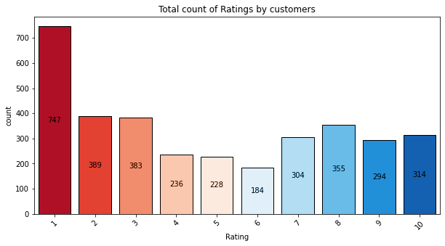
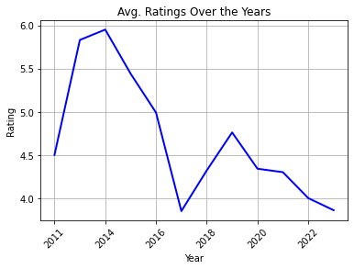
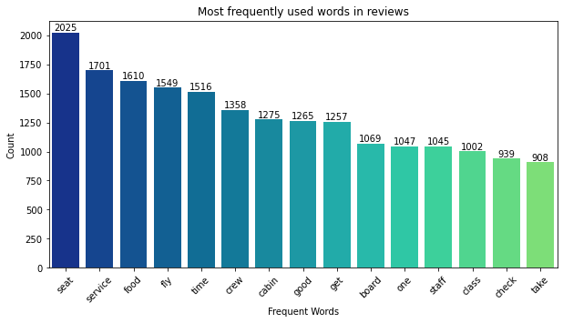
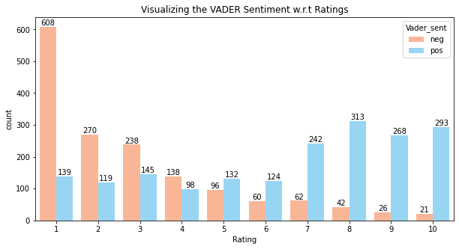
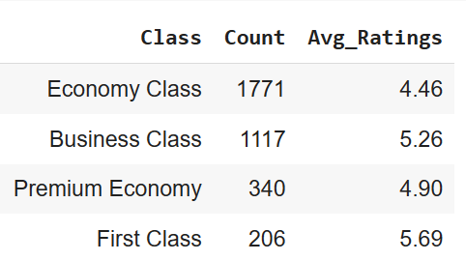
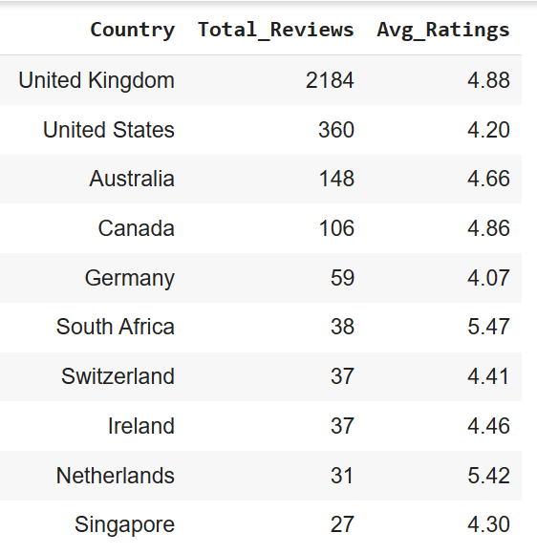
Key Findings & Sentiment Analysis – Customer Feedbacks
4.84/10
Average Ratings
51%
Negative Reviews
37%
Positive Reviews
12%
Neutral Reviews
65+ countries
Business Operations
Class wise Count, Average ratings
Class wise Count, Average ratings

Slide 3
Conclusion
For the year 2022, the average rating was 4/10.
Post year 2014, the average ratings have dropped significantly over the years.
The most frequent words used for positive feedbacks are good, excellent, food, seat, comfortable, cabin crew, staff, board, nice, etc.
The most frequent words used for negative feedbacks are hour, service, fly, seat, time, travel, delay, poor, disappoint, etc.
Customers travelled mostly with BA's Economy class and Business Class accounting for 84% overall.
Performed Vader’s rule based approach on reviews for Sentiment analysis. Results, found satisfactory as compared to other rule based model.
To survive in the market, BA should consider transforming seats into nice cushion, enhance services, improve food quality and variety, strictly comply with ISO standard and improve overall flight experience.
Strong quality assurance check is must for services outsourced (if any).

Slide 4
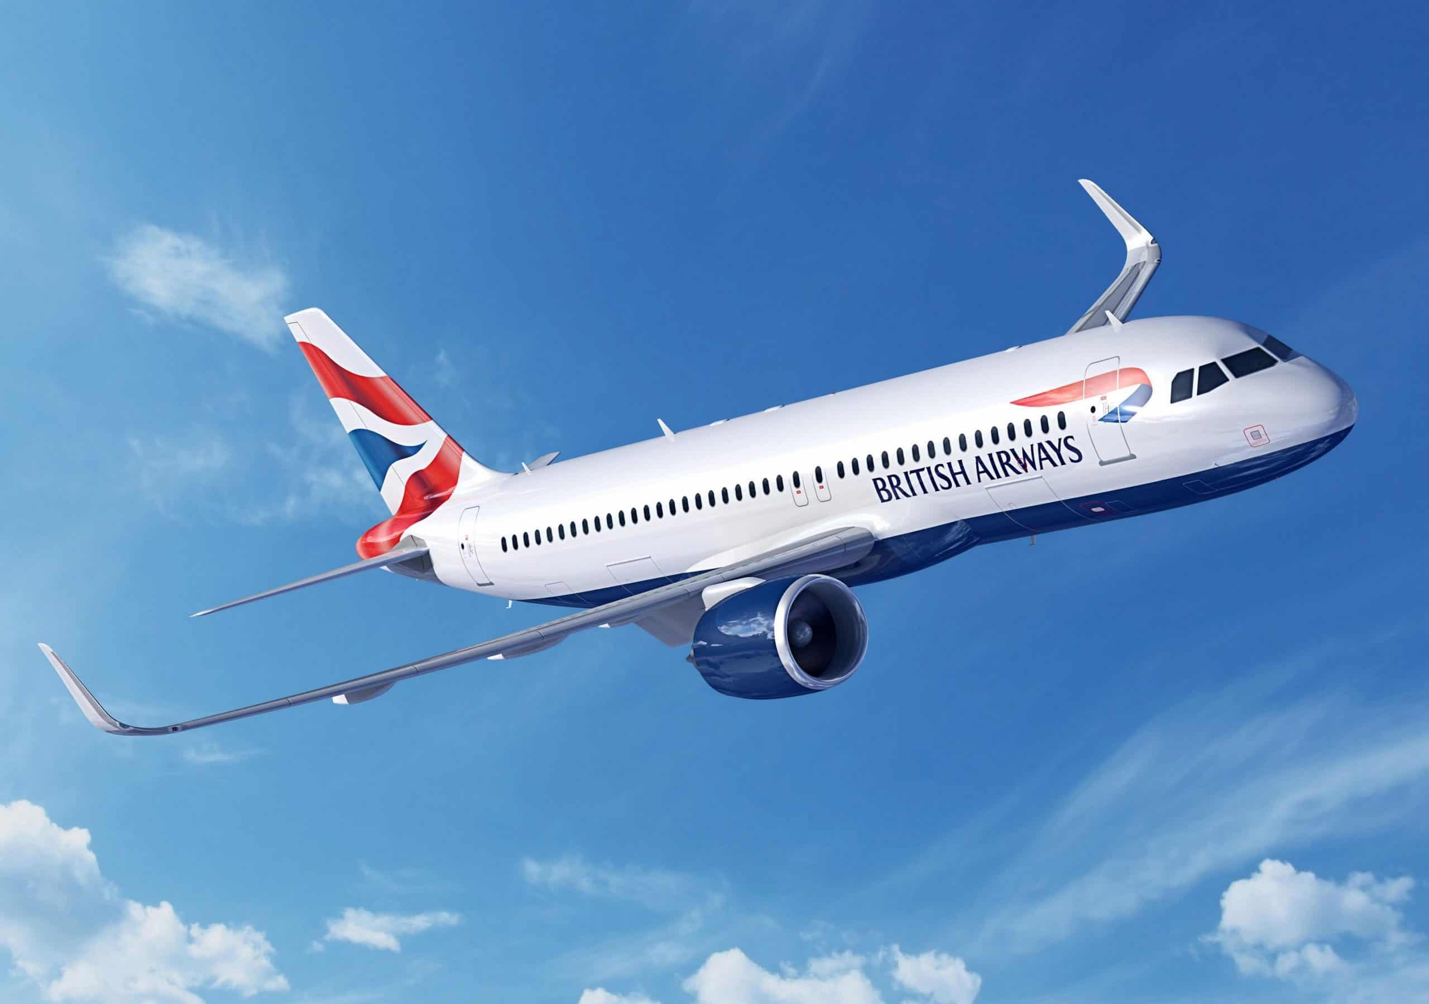
Happy Journey!

